Slide 1
Activity Diagrams
Edited by R.A. Mustafa Büyükkeçeci from various UML resources.

Slide 2
Activity Diagrams Overview
Definition: Activity diagrams are graphical representations of workflows of stepwise actions that are part of a larger activity.
UML Diagram Type: Behavioural.

Slide 3
Activity Diagrams Overview - 2
Use cases show what your system should do.
Activity diagrams allow you to specify how your system will accomplish its goals.
Activity diagrams show high-level actions chained together to represent a process (activity) occurring in your system.
For example, you can use an activity diagram to model the steps (actions) involved with creating a blog account, student registration or booking a concert ticket.
Activity is a sequence of actions that take finite time and can be interrupted. However, action is an atomic task that cannot be interrupted (at least from user’s perspective).

Slide 4
Activity Diagrams Overview - 3
“Booking a Concert Ticket” activity consists of the following actions:
Customer calls ticket office.
Ticket representative asks what event person wants tickets for.
Customer tells representative event choice.
Ticket representative tells customer available seats and prices.
Customer tells representative seating choice.
Ticket representative reserves seats.
Ticket representative asks for credit card and billing address.
Customer gives requested information.
Ticket representative charges credit card.
Ticket representative mails tickets.

Slide 5
Activity Diagrams Overview - 4
Activity diagrams are one of the most accessible UML diagrams since they use symbols similar to the widely-known flowchart notation; therefore, they are useful for describing processes to a broad audience.
In fact, activity diagrams have their roots in flowcharts, as well as UML state diagrams, data flow diagrams (DFDs), and Petri Nets.
Activity diagram is used to visualize and exploit the opportunity of parallel (concurrent) and consecutive processing. However, flow chart is limited to sequential process with condition checking points.

Slide 6
Activity Diagrams Overview - 5
Activity diagrams can be used through a project, from business analysis through to program design.
An activity diagram is drawn from a high level, so it gives an overview of a system.
This high level view is mainly for business users or any other person who is not a technical person.
Following are the main usages of activity diagram:
Modelling work flow by using activities.
Modelling business requirements.
High-level understanding of the system's functionalities.
Investigate business requirements at a later stage.

Slide 7
Activity Diagrams Overview - 6
Activity diagrams are constructed from a limited number of shapes, connected with arrows.
Activity diagram has:
Rounded rectangles that represent actions,
Diamonds that represent decisions or merge of actions,
Bars that represent the start (split-fork) or end (join) of concurrent activities,
A black circle, which represents the start (initial state) of the workflow,
An encircled black circle, which represents the end (final state), and
Arrows that run from the start towards the end and represent the order in which activities happen, they do not show any message flow.

Slide 8
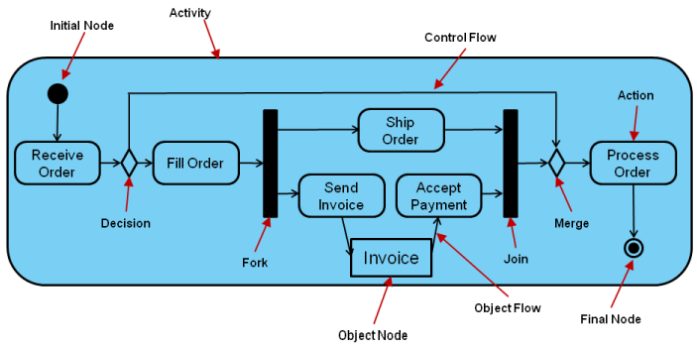
Activity Diagrams Overview - 7
Label
Order Fulfilment

Slide 9
Activities
An activity is shown as a round-cornered rectangle enclosing all the actions, control flows and other elements (object, object flows, etc.) that make up the activity.
Inside the activity, a number of actions are linked by activity edges to describe a workflow.
The word “activity” is often mistakenly used instead of “action” to describe a step in an activity diagram, but they are not the same.
Washing a car is an activity. This activity consists of some steps, such as lather, rinse and dry, which are called as actions.

Slide 10
Activities - 2
An activity is labeled by its name (noun and verb phrases).
Name of the activity must be written in the middle of the activity frame.
Activities should have only one start point, but may have a number of end points.
An activity may be physical, such as “Inspect Forms”, or non-physical (e.g., electronic) such as “Display Create Student Screen”.

Slide 11
Actions
An action represents a single step within an activity, that is, one that is not further decomposed within the activity.
Actions are denoted by round-cornered rectangles with a descriptive name (noun and verb phrase) for the action inside.
The execution of an action represents some transformations or processes in the modeled system (creating objects, setting attribute values, linking objects together, invoking user-defined behaviors, etc.).

Slide 12
Actions - 2
An action is a unit of work that needs to be carried out.
In practice, this can be large or small, taking place over a long or short period of time.
A business action, such as debt recovery, might take many weeks.
A computer action, such as changing an attribute of a customer, can be almost instantaneous.
However, in activity diagrams we can not show durations of actions.

Slide 13
Objects
Sometimes it is useful to indicate on an activity where an action impacts an object.
Objects don’t have to be software objects, they can be physical things such as a bill, a paper document and a hardware.
This is done by placing an object on the diagram (a rectangle) and linking it to an action by a dependency relationship.
Such dependencies are known as object flows because they indicate how an object is used in a flow of control.
An object node is labelled by its class name.

Slide 14
Edges (Flows)
A transition between action states is called an activity edge, which is represented as a straight line ending with an arrow that points to the next state.
Elements are connected by activity edges to form flows.
Activity edges can not have events associated with them, but they can have guard conditions.
There are two kinds of edges: control and object edges.
Edge
Action 1

Slide 15
Control and Object Flow (Edge)
Control and object flow connector arrows are unidirectional.
A control flow (edge) shows the flow of control from one action to the next.
An object flow (edge) shows the flow of an object from one activity (or action) to another activity (or action).
Control Flow
Action 1
Action 2
Object Flow
Object
Action

Slide 16
Parameter Nodes
Activity parameter nodes are object nodes at the beginning and end of flows that provide a means to accept inputs to an activity and provide outputs from the activity, through the activity parameters.
“Process Paper” Activity
Process Paper
Parameter Node
Parameter Node
Wood
Create Pulp
Press Paper
Package Reams
Ream
Input
Output

Slide 17
Activity Initial, Final and Flow Final Nodes
The activity initial node is the entry point to the flow in an activity.
Only one initial node is allowed in an activity.
Activity final nodes are drawn as black dots with a surrounding circle.
Because a flow may take alternative routes through an activity, the activity may terminate at more than one point.
There can be multiple parallel flows (see fork node) executing in an activity, a flow may terminate while other flows continue. This is indicated by a flow final node.
A flow final node does not trigger the termination of the activity and has no effect on the other flows.

Slide 18
Decision and Merge Nodes
A decision node is used to represent a test condition to ensure that the control flow or object flow only goes down one path.
Decision nodes are represented by diamonds and labelled with the decision criteria (also known as guard condition) to continue down the specific path.
Guard conditions are represented by square brackets.
A single transition enters each diamond and multiple transitions come out.
Main Flow
Decision Criteria 1
[Guard Condition]
Decision Criteria 2
[Guard Condition]

Slide 19
Decision and Merge Nodes - 2
A merge node is used to bring back together different decision paths that were created using a decision node.
Merge nodes do not contain any decision criteria.
Merge nodes should only be used to bring together flows, which are alternatives, not parallel flows – parallel flows need to be brought together with a join component.
A merge also appears as a diamond but it has multiple transitions leading into and only one leading out.
Flow 1
Flow 2
Main Flow

Slide 20
Fork and Join Nodes
Sometimes it makes sense to allow a number of actions to run in parallel.
An activity edge can be split into multiple paths and multiple paths combined into a single activity edge using a fork node and a join node.
A fork node may have one entry activity edge and two or more exit activity edges.
Single Flow
2 or More Simultaneous Flows

Slide 21
Fork and Join Nodes - 2
Flow final nodes can be used with the fork nodes.
When a flow reaches a flow final node it stops, but other flows may continue executing within the action.
There are no guard conditions in fork.
Prepare Benefits Paperwork
Submit Employee Info to Insurance Company
Setup User Office Space
Setup User Account

Slide 22
Fork and Join Nodes - 3
A join node must have multiple entry activity edges and one exit activity edge.
It is permissible to merge a join and a fork together so that multiple parallel flows synchronize and then split into another set of parallel workflows.
It is important when workflow is split into parallel flows that these flows are recombined on the same diagram.
Note that multiple exits and multiple entries to an action have implicit fork and join semantics.
Single Flow
2 or More Simultaneous Flows

Slide 23
Calling Other Activities
As detail is added to your activity diagram, the diagram may become too big, or the same sequence of actions may occur more than once.
When this happens, you can improve readability by providing details of an action in a separate diagram, allowing the higher level diagram to remain less cluttered.
Pitch fork action now has an upside-down pitchfork symbol indicating that it is a call activity node.
A call activity node calls the activity corresponding to its node name.

Slide 24
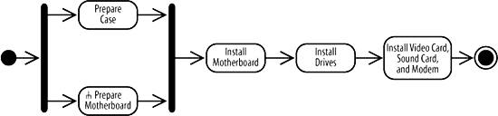

Calling Other Activities - 2
Pitchfork Symbol

Slide 25
Explanation of the Previous Diagram
The “Prepare Motherboard” node in invokes the “Prepare Motherboard” activity.
You associate a call activity node with the activity it invokes by giving them the same name.
Call activities essentially break an action down into more details without having to show everything in one diagram.
The “Prepare Motherboard” activity diagram has its own initial and activity final nodes.
The activity final node marks the end of “Prepare Motherboard”, but it doesn't mean the calling activity is complete.
When “Prepare Motherboard” terminates, control is returned to the calling activity, which proceeds as normal.

Slide 26
Swim Lanes (Activity Partition)
A swim lane, or an activity partition, is a kind of activity group for identifying actions that have some characteristic in common.
A swim lane is labeled at the top with the name of the individual or object responsible.
Each lane is separated from the others by solid vertical and horizontal lines.
Therefore, swim lanes can either be horizontal or vertical.

Slide 27
Swim Lanes (Activity Partition) - 2
Every activity belongs to exactly one swim lane but edges can cross partitions freely.
Partitions are useful because they arrange the actions of an activity into areas corresponding to different objects or business roles that perform the actions, but they might also elongate the diagram.
If you are using swim lanes you don’t need to draw the “activity component” to define the system boundary.

Slide 28
Wrong Notation of Swim Lanes
Don’t use activity component. Swim lanes behave as a container object.

Slide 29
Vertical and Horizontal Swim Lanes
Partition 1 | Partition 2 | ... | Partition n
Partition 1
Partition 2
...
Partition n

Slide 30
Swim Lane Features
These are the features of swim lanes:
Each action is assigned to one swim lane.
Activity flows can cross lanes.
Swim lanes do not change ownership hierarchy.
Swim lane association (representing field population) to a class (only) can be created by dragging the class from the browser to the swim lane name compartment.
The relative ordering of swim lanes has no semantic significance.
There is no significance to the routing of an activity flow path.
Parts representing internal behavior can be specified on swim lanes.

Slide 31
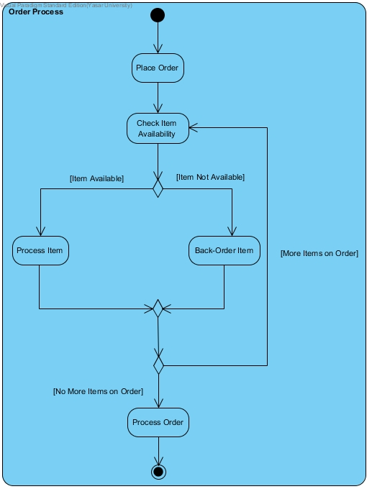

Slide 32
